Slide 1
Gifted Learners Differentiate Curriculum in the Regular Classroom
By Theresa Monaco, Christen crayton, Maimuna Abdilah, and Chau Dao

Slide 2
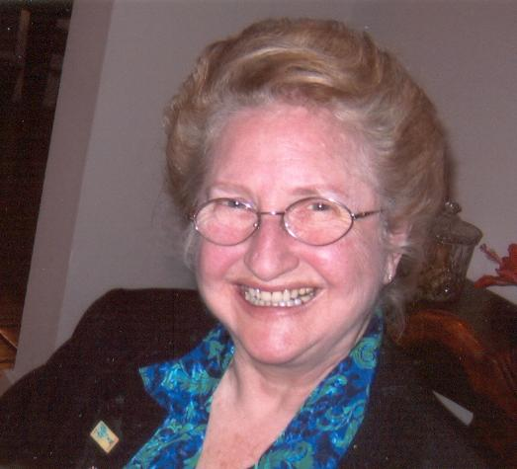
About the Authors: Theresa Monaco
Theresa Monaco is Professor of Curriculum and Instruction and Director for Center for Gifted and Talented Education at the University of Houston. She has authored:
Monaco, T. (Ed.) 2ndEdition (2002) Biographical Directory of Leaders in Gifted Education. Royal Fireworks Press, Unionville, N.Y.
Monaco, T, Brandi Allen, Azhar Zafar (2011) http://www.nyu.edu/classes/keefer/waoe/monacostory.pdf, Hyperlinked for public viewing . World Association for Online Education: The WWW Journal of Online Education. Updated by Publisher.
Teachers Identify and Support At-Risk Gifted Students. Volume 8 Issue 3 -Jun 3, 2010 -11:27:53 AM. By Theresa Monaco, Danna Eichenold, Victoria Casper, Claudia V. Gonzales, Susan Jackson, Maria Earle, Eva Marie Bisaillon

Slide 3
Abstract
The purpose of the assignment was to:
Provide your vision of an ideal problem solving unit that helps teachers teach students who are having classroom, academic and social problems.
Understand the cultural and social economic factors that impact on the identification and instruction of the gifted student with particular emphasis on special populations.
Become familiar with definitions/taxonomies of cognitive and affective skills as used several major curriculum models for critical creative problem solving and decision making instruction.

Slide 4
About the Authors: Christen Crayton
Christen Crayton was born and raised in Austin, Texas. She has always had a passion for children, learning, and teaching. Until high school, Crayton believed she wanted to be a lawyer because of her eagerness to debate and be thorough. After entering high school, she knew she wanted to teach but at the high school level. After receiving her first job in college as a camp counselor, Crayton changed her major to elementary education. She enjoyed the vibe of being on a high school campus but enjoyed the smiles, hugs, and curiosity of younger children more. Crayton has experience as a research assistant, a tutor, a customer service representative and a hospitality coordinator. She believes her previous experience have given her some of the fundamental characteristics of a quality educator. Her teaching philosophy is to empower, encourage, and restore students who believe they cannot achieve. In the future, Crayton plans to attend Vanderbilt University in Nashville, Tennessee to complete her masters and doctorate degree in Education. She dreams of traveling the world, being married, beginning her own Non-profit, and having children of her own. Christen Crayton is ready to begin a career in teaching knowing that she is positively impacting students to become quality citizens and leaders.

Slide 5



Verbs

Slide 6
Objective(s):
Students will identify the ten verbs in a teacher created passage: shake, jump, dance, clap, snap, bend, wave, skip, whisper, and march.
Students will demonstrate their understanding of verbs in a game of charades.
Students will listen and show the verbs in the game “Teacher Says.”
Students will identify verbs in sentences.
Student will create five or more sentences using their own verbs.
Students will watch a soundless video on action verbs and create a song, story, narration, or dance to accompany.

Slide 7
TEKS
6) Reading/Vocabulary Development. Students understand new vocabulary and use it when reading and writing. Students are expected to:
(A) Identify words that name actions (verbs) and words that name persons, places, or things (nouns);

Slide 8


What is a verb

Slide 9
A verb is…
An action: something you can do.

Slide 10



examples

Slide 11


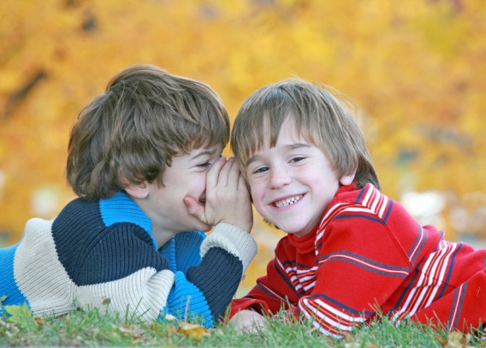
examples

Slide 12
Can you think of other verbs? Some things we can do.

Slide 13
Great Job!

Slide 14
Find the verbs
Rowan loves to sing in the morning.
Evelyn likes to read books.
Taylor will bake a cake.
Can we play outside?
Do you like to dance?

Slide 15
Way to Go!

Slide 16

Adam the Dancer There was a young boy named Adam who loved to dance. He loved to shake, jump, and bend to the tango as the music beats faster and faster. One day, his teacher decided to ask him to dance in front of the class. She said in a whisper, “Would you like to show the class, what you can do? “Yes, Ms. Smith, I would love to, replied Adam. As soon as Ms. Smith turned on the music, he began to dance. His classmates began to wave their hands as he slightly moved to the beat. With the snap of his fingers, he suddenly flips in the air and smiles to his classmates. With a small march, he asks his classmates to join him on the floor. With a skip, Ms. Smith turns the music on again, and with the clap of her hands she exclaims, “Let’s dance!”
find the verbs in the passage below.

Slide 17
Your turn
Create five or more sentences using your own verbs.
Share your sentences with a partner when you are finished.

Slide 18
Next we will watch a soundless video
You can create a:
Song
story
Words for the video

Slide 19


Slide 20
Your turn!
Let’s get busy using verbs!

Slide 21
About the Authors: Maimuna Abdilah
My name is Maimuna Abdilahi, known as Mona. I am originally from Somalia, and lived in Egypt for my early childhood years. I have been living in Houston, TX for the past 13 years with my parents, brother, and two sisters. During my undergraduate career, I had the opportunity to work with Houston Independent School District as a refugee tutor. I worked at different schools tutored students' from different grade levels. This wonderful experience has allowed me to gain so much knowledge about teaching and helped increase my passion and love to children and teaching. This December, it is my hope to graduate from the Quest program and secure a teaching position and continue with my dream of teaching children. With the Wonderful support of my family, close friends and professors, and continuing research in teaching I know I will become a teacher that young children can look up and ensure their success.

Slide 22
Community Helpers
Who are the people who help us each day? Let’s take a look and find out!

Slide 23
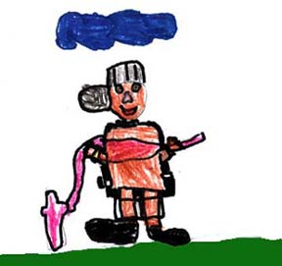
Firefighter
Firefighters are very brave. They help us when we have a fire.

Slide 24
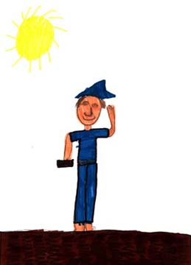
Mail Carrier
The mail carrier brings us our mail. He works at the post office.

Slide 25

Doctor
Doctors help us whe we are sick. They give us medicine to help us feel better

Slide 26
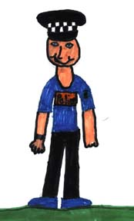
Police Officer
Police officers protect us and keep us safe. They are our friends.

Slide 27
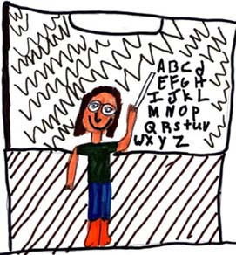
Teacher
Teachers work at schools in the community. They help boys and girls to learn.

Slide 28
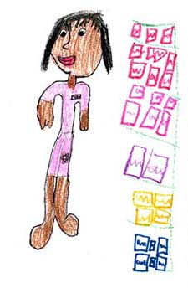
Store Clerk
The store clerk helps us find the things we need to buy when we are shopping. She tells us how much money things cost.

Slide 29
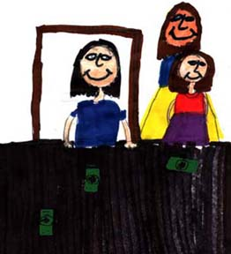
Bank Teller
The bank teller helps us at the bank. She cashes checks and gives us money.

Slide 30
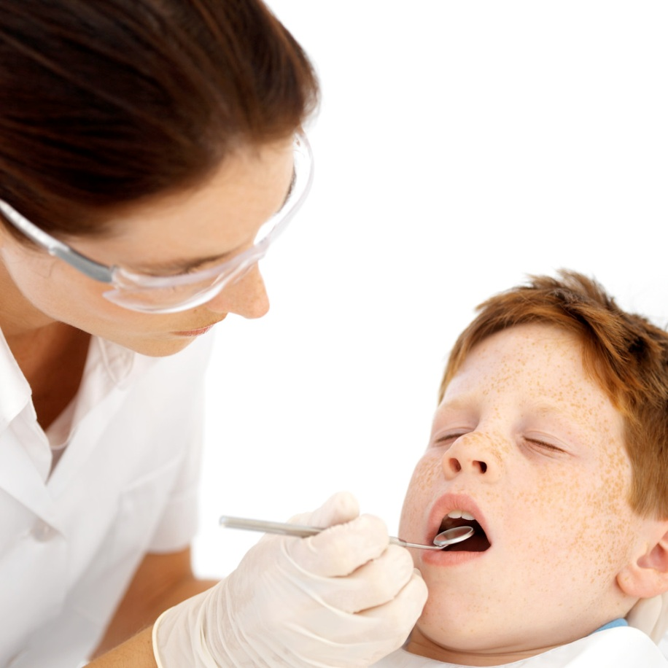
Dentist
Dentists help us keep our teeth clean. They clean germs and fix cavities on your teeth.

Slide 31
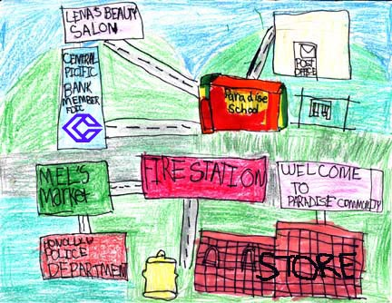
A Community

Slide 32
About the Authors: Chau Dao
My name is Cathy Chau Dao. I am so excited to start my student teaching this semester, and I am looking forward to having my own classroom in the near future. Over the past four years in college, I have learned so much about myself, what my personal teaching philosophy is like, and different ways that I can improve to become a better teacher for my future classroom. This summer I had the opportunity to teach English in Vietnam, and I can honestly say that it has been one of the most amazing experiences of my entire life. I am so grateful for the opportunity to learn how to become a better teacher, while helping my students in Vietnam learn English better. My goal for this semester is to learn as much as I can from my cooperating teacher, my supervisor, my professors, and from my classmates.
Most importantly, I hope to give my students all the attention, knowledge, and time that they deserve to ensure that they have the best education that I can help them receive. I hope to leave my last semester in college as a student teacher better prepared to become a certified teacher with my own classroom in the near future. I am looking forward to be able to work with you as well as learn from you this semester.

Slide 33
2011 Japanese Tsunami and Radioactive Waste
Cathy Dao

Slide 34
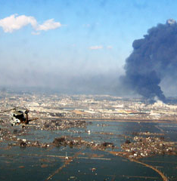
What happened in Japan?
March 11, 2011
9.0 magnitude earthquake strikes off coast of Honshu, Japan
Damage off northern coast of Japan

Slide 35
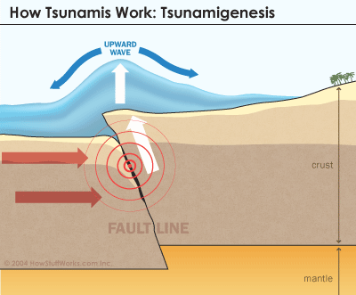
What is a tsunami?
Name comes from Japanese words
“tsu” – harbor
“nami” – waves
Earthquake in ocean causes HUGE waves
100 ft. tall
Waves can travel faster than airplanes!

Slide 36
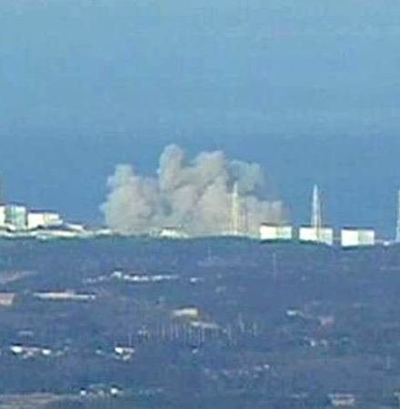
What is Radioactive Waste?
Waste product of nuclear power plant
Very harmful in large amounts
The tsunami caused damage to a nuclear power plant

Slide 37
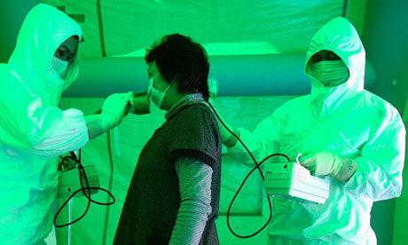
Where is it going?
Some radioactive waste is leaking out of damaged plant
It is draining into water supply
People may drink this radioactive water
Increased risks for cancer/diseases
Japanese woman getting screened for radioactive exposure

Slide 38
What can we do?
Ask the Japanese government to NOT let their people drink the water
Ask them to get drinking water from safe, clean sources not affected by radioactive waste
Send them encouraging words during this difficult time

Slide 39
Using Literature in Mathematics: Gifted Students' Comments, by Carolyn L. Pinchback, Gifted Child Today (Waco, Tex.: 2000) 24 no1 36-43 Wint 2001
Mapping Out New Directions? Or Using the Same Roadmap?, by Tracy L. Riley, Gifted Child Today (Waco, Tex.: 2000) 24 no1 24-9, 60-1 Wint 2001
STAFF DEVELOPMENT: OLD DOGS CAN LEARN NEW TRICKS, by Felicia A. Dixon; Richard Willis; John Benedict; Eugene Gossman, The Teacher Educator 36 no3 219-32 Wint 2001
LESSONS LEARNED FROM GIFTED CHILDREN ABOUT DIFFERENTIATION, by F. Richard Olenchak, The Teacher Educator 36 no3 185-98 Wint 2001
A LEGACY OF PROMISE: REFLECTIONS, SUGGESTIONS, AND DIRECTIONS FROM CONTEMPORARY LEADERS IN THE FIELD OF GIFTED EDUCATION, by Mary G. Rizza; Marcia Gentry, The Teacher Educator 36 no3 167-84 Wint 2001
Integrating an affective component in the curriculum for gifted and talented students, by Karen Johnson, Gifted Child Today (Waco, Tex.: 2000) 24 no4 14-18 Fall 2001
Gifted Children in the Current Policy and Fiscal Context of Public Education: A National Snapshot and State-Level Equity Analysis of Texas, Bruce D. Baker, Educational Evaluation & Policy Analysis 23 no3 229-50 Fall 2001
Beliefs and Attitudes of Novice Teachers Regarding Instruction of Academically Talented Learners, Karen

Slide 40
Course References
An Analysis of Multiple Intelligences Theory and Its Use with the Gifted and Talented, by Daniel Fasko, Jr., Roeper Review 23 no3 126-30 Ap 2001
Perfectionism Differences in Gifted Middle School Students, by Del Siegle; Patricia A. Schuler, Roeper Review 23 no1 39-44 S 2000
An Effective Mathematics and Science Curriculum Option for Secondary Gifted Education, by Tandra L. Tyler-Wood; Mark Mortenson; Dawn Putney; Michael A. Cass, Roeper Review 22 no4 266-9 Je 2000
Academic Self-Concept of Talented Students: Factor Structure and Applicability of the Internal/External Frame of Reference Model, by Frances Lee Lai Mui, Alexander Seeshing Yeung, Renae Low, & Putai Jin, Journal for the Education of the Gifted 23 no3 343-67 Spr 2000
Talent Identification and Development in Taiwan, by Wu-Tien Wu, Roeper Review 22 no2 131-4 Ja 2000

